Slide 1
CSCE 1035 Computer Programming I Chapter 1 Introduction to Python 3
University of North Texas

Slide 2

1.1 Programming (General)
“Computer programming is the process that professionals use to write code that instructs how a computer, application or software program performs.
At its most basic, computer programming is a set of instructions to facilitate specific actions.”

Slide 3

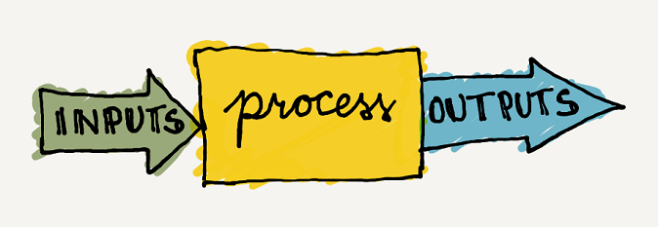

Computer Program Basics
A computer program consists of instructions executing one at a time
Basic instruction types are
Input: program gets data from keyboard, file, network, etc.
Process: program performs computations on that data
Output: program puts that data on a screen/terminal, file, etc.

Slide 4
Computer Program Basics
Computational Thinking (CT) is an approach to solving problems, designing systems, and understanding human behavior that consists of
Decomposition
Breaking down data, processes, or problems into smaller, more manageable parts
Pattern Recognition
Observing patterns, trends, and regularities in data
Abstraction
Identifying general principles that generate these patterns
Algorithm Design
Developing step-by-step instructions for solving this and similar problems

Slide 5
Computer Program Basics
Algorithm
A sequence of precise instructions that leads to a solution
Should not be specific to a programming language
Individual list of steps should be as simple as possible
Program
An algorithm expressed in a language the computer can understand
Algorithm development should always
precede coding a program

Slide 6
Program Design
Programming is a creative process
No complete set of rules for creating a program
This means that two programs doing the same thing will be completely different!
Program Design Process
Problem Solving Phase (algorithm development)
Result is an algorithm that solves the problem
Implementation Phase (coding and testing)
Result is the algorithm translated into a programming language – a program

Slide 7
Program Solving Phase
Be certain the task is completely specified
What is the input?
What information is in the output?
How is the output organized?
Develop the algorithm before implementation
Experience shows this saves time in getting your program to run
Test the algorithm for correctness
Refine the algorithm successively to get a step-by-step detailed algorithm
Pseudocode is an artificial and informal language that helps programmers develop algorithms, similar to everyday English

Slide 8
Implementation Phase
Translate the algorithm into a programming language
Easier as you gain experience with the language
Execute the source code frequently with sample data
Locates errors in using the programming language
Verify correctness of results
Results may require modification of algorithm and program

Slide 9
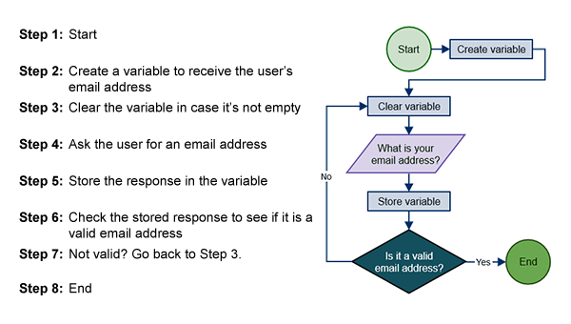
Algorithm Examples

Slide 10
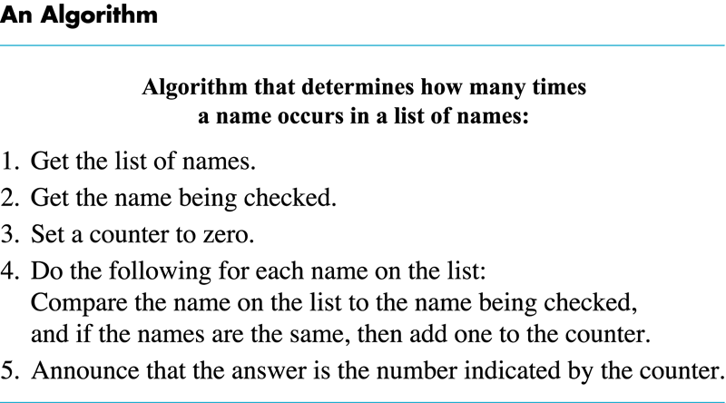
Algorithm Examples

Slide 11
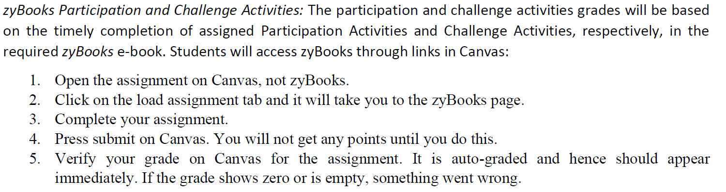

Slide 12
1.2 Programming Using Python

Slide 13
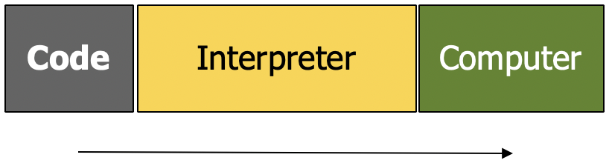
Python Interpreter
The Python interpreter is a loop that
Reads an expression
Evaluates the expression
Prints the result
If the result is None, the interpreter does not print it
Python can be executed interactively or via a program
Interactively
You type one expression at a time
The interpreter evaluates the expression and prints its value
Running a Python program
Python evaluates all the statements in the file, in order
Python does not print their values (but does execute print() statements)

Slide 14
Python Interactive Mode
Statements and expressions can be typed at prompt
$ python3
Python 3.6.9 (default, Jul 17 2020, 12:50:27)
[GCC 8.4.0] on linux
Type "help", "copyright", "credits" or "license" for more information.
>>> print("Hello, world")
Hello, world
>>> x = 12**2
>>> x/2
72.0
>>> # this is a comment
...
>>> quit()
Use quit() or Ctrl-D (i.e. EOF) to exit

Slide 15

Exercise: Compute Cylinder Volume
Write a program to compute the volume of a cylinder with user input radius and height
Problem Solving Methodology
Problem Statement
Input/Output Description
Hand Example
Algorithm Development
Implementation
Testing
radius
height

Slide 16

Solution: Compute Volume (cont’d)
Problem Statement
Compute the volume of a cylinder with radius and height
Input/Output Description
Hand example
radius = 2, height = 3, PI = 3.14
volume = 37.68
radius
volume
height

Slide 17
Solution: Compute Volume (cont’d)
Algorithm Development
Assign PI = 3.14 constant
Read radius from keyboard as float
Read height from keyboard as float
Calculate Volume:
Print volume
Now write the program…

Slide 18
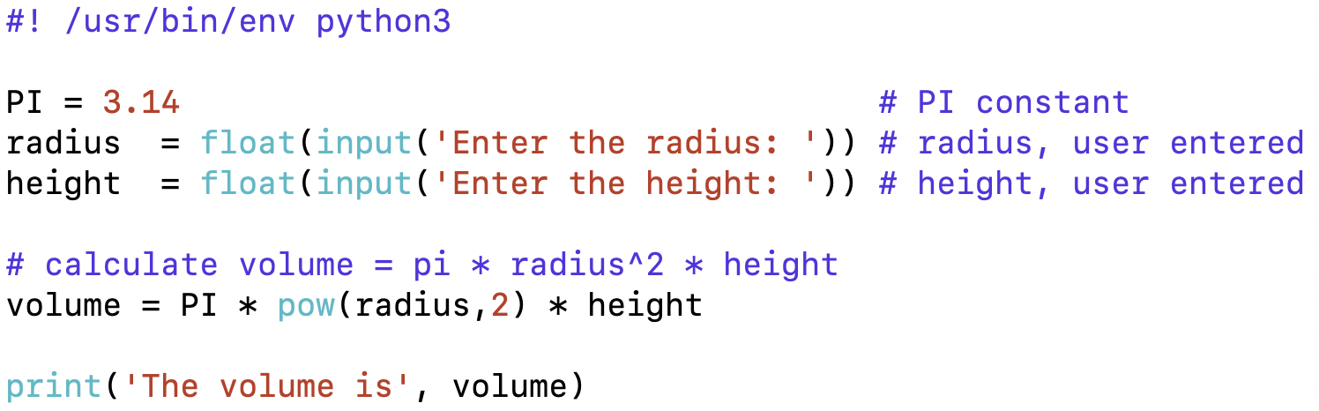
Running a Python Program
Programs can be run by typing at the command line
$ python3 CH1-A.py
Enter the radius: 2
Enter the height: 3
The volume is 37.68
(in you cell server, create a directory csce1035_Class:
mkdir csce1035_Class
Copy the code related to the first chapter here:
cp –r /nfs/home/UNT/bj0141/public/csce1035/CH-1 . )

Slide 19
1.3 Basic Input and Output

Slide 20
Basic Text Output
print() produces text output on the terminal
Each use of print() starts on a new line
The addition of end=' ' allows additional output to be printed on the same line with another print() statement
Output can be moved to the next line by printing "\n", known as a newline character
print('String Literal')
Text enclosed in quotes is known as a string literal
print(Expression)
print(Item1, Item2, …, ItemN)
Prints several messages and/or expressions on same line

Slide 21
Basic Input
input() reads a string of text from user input, including numbers, letters, or special characters
You can assign/store the result of input() into a variable
Reading input is achieved using the input() function.
The function input() causes the interpreter to wait until the user has entered some text and has pushed the enter key
Example
print('Enter your name:', end=' ')
name = input()
-- or equivalently --
name = input('Enter your name: ')
What if you wanted the user to enter an integer?

Slide 22
Basic Input
Variables, literals (e.g., string literals), and constants have a type in Python
A type determines how a value can behave
Reading from input always results in a string type
Python knows the difference between an integer and a string
E.g., the string '123' (with quotes) is fundamentally different from the integer 123 (without quotes)
You may have to use type conversion to use input as an integer (or other type)
Combine input() and int() to read in a string from the user and then convert that string to an integer for use in a calculation
Remember our earlier Cylinder Volume example using float()?

Slide 23
1.4 Errors

Slide 24
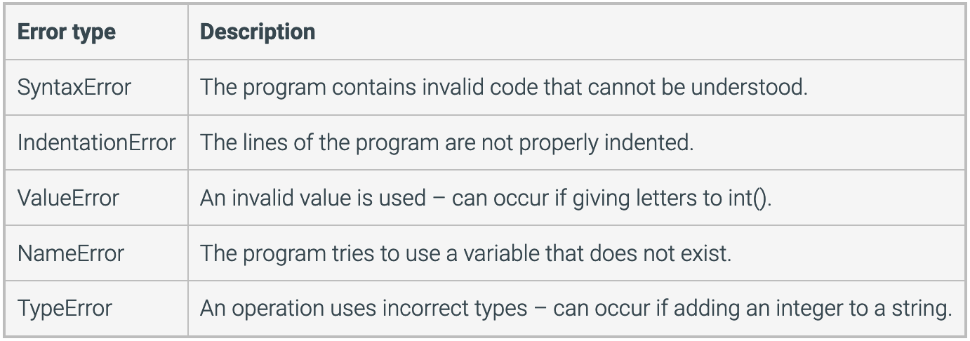
Program Errors
Syntax errors
Violation of the grammar rules of the language
Run-time errors
Error conditions detected by the computer at run-time
Logic errors
Errors in the program’s algorithm
Most difficult to diagnose as computer does not recognize an error
Common Error
Types

Slide 25
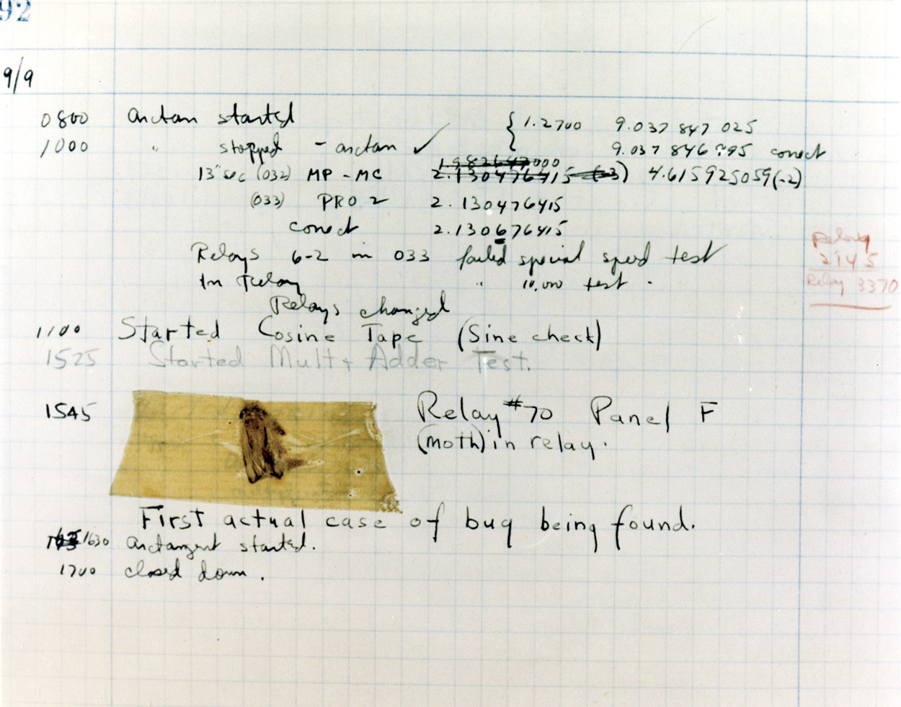
Debugging
Bug
A mistake in a program
Debugging
Eliminating mistakes in programs
Term used when a moth caused a failed relay on the Harvard Mark 1 computer. Grace Hopper and other programmers taped the moth in logbook stating: "First actual case of a bug being found."

Slide 26
General Debugging Techniques
Keep an open mind
Don’t assume the bug is in a particular location
Divide into manageable parts and execute code frequently
Don’t randomly change code without understanding what you are doing until the program works
This strategy may work for the first few small programs you write, but is doomed to failure for any programs of moderate complexity
Localize the error
Narrow down the bug using print() statements
Use a debugging tool, such as pdb (more later)

Slide 27
1.5 Development Environment

Slide 28
Writing a Python Program
Code development is usually done in an integrated development environment (IDE)
IDLE is official Python IDE (not installed on our CSE machines)
Other IDEs
Eclipse with PyDev (https://www.pydev.org/) plugin
PyCharm (https://www.jetbrains.com/pycharm/download)
Available web-based tools
CodePad (http://codepad.org/)
Repl (https://repl.it/languages/python3)
Text editors with color-coding are available on our Linux CSE machines
vim or nano are used in this course

Slide 29
1.6 Computers and Programs (General)

Slide 30
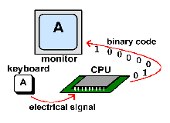

How Does It All Work?
When you type the letter A on your keyboard, electrical signals are sent from the keyboard to CPU
The CPU turns the signals into binary code
Then, the computer reads the code and sends it on to the monitor to display the letter A
So why is A represented here as
0 1 0 0 0 0 0 1

Slide 31
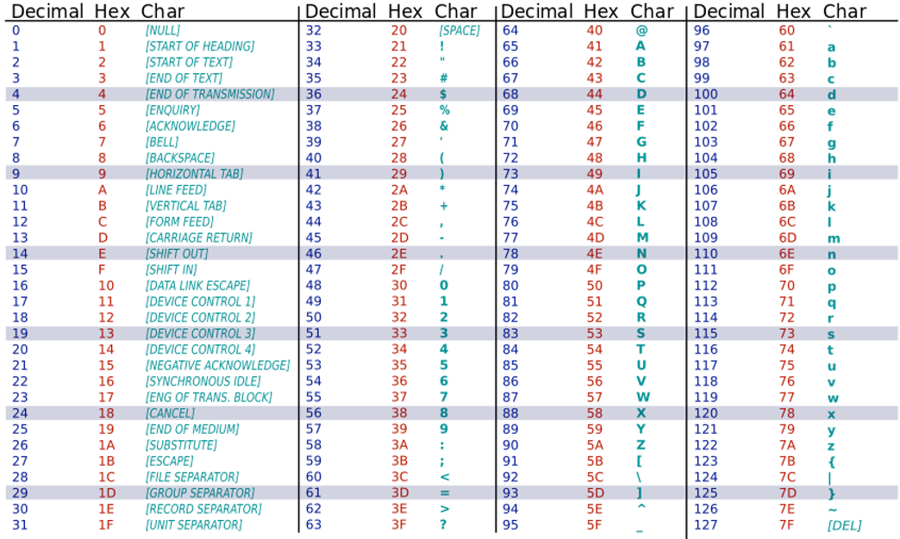
ASCII Table
Every printable and special character encoded as a sequence of bits
ASCII is 7-bit encoding scheme capable of supporting 2^7 = 128 characters

Slide 32
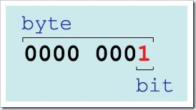
Bits and Bytes
Bit
Short for binary digit
Smallest data unit of a computer
Two stable states represented by 0 and 1
Byte
Sequence of 8 bits
A nibble is a sequence of 4 bits
Binary Unit Conversions
KiloByte | KB | 1 KB | 2^0 KB | 2^10 bytes | 1024 bytes
MegaByte | MB | 1024 KB | 2^10 KB | 2^20 bytes | 1,048,576 bytes
GigaByte | GB | 1024 MB | 2^10 MB | 2^30 bytes | 1,073,741,824 bytes

Slide 33
High-Level Languages
Common programming languages include
C C++ Java Pascal Visual Basic FORTRAN Perl PHP Lisp Scheme Ada C# Python
These high-level languages…
Resemble human languages
Are designed to be easy to read and write
Use more complicated instructions than a CPU can follow
Must be translated to processor instructions (e.g., assembly language) and then zeros and ones for the CPU to execute a program
This is done using a compiler or interpreter, which translate high-level programs into executable programs

Slide 34
Low-Level Languages
An assembly language command such as
ADD X Y Z
might mean add the values found at X and Y in memory, and store the result in location Z
Assembly language must be translated to machine language (zeros and ones)
0110 1001 1010 1011
CPU can understand and follow machine language

Slide 35
1.7 Computer Tour

Slide 36
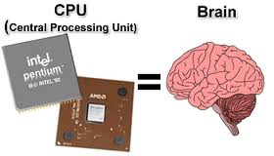
Computer Organization
Five main components
Input devices
Allows communication to the computer
Output devices
Allows communication to the user
Processor (CPU)
Instructions execute at a rate governed by the processor’s clock
Main memory
Memory locations containing the running program
Secondary memory (storage)
Permanent record of data often on a disk or removable media such as a USB drive or CD/DVD

Slide 37
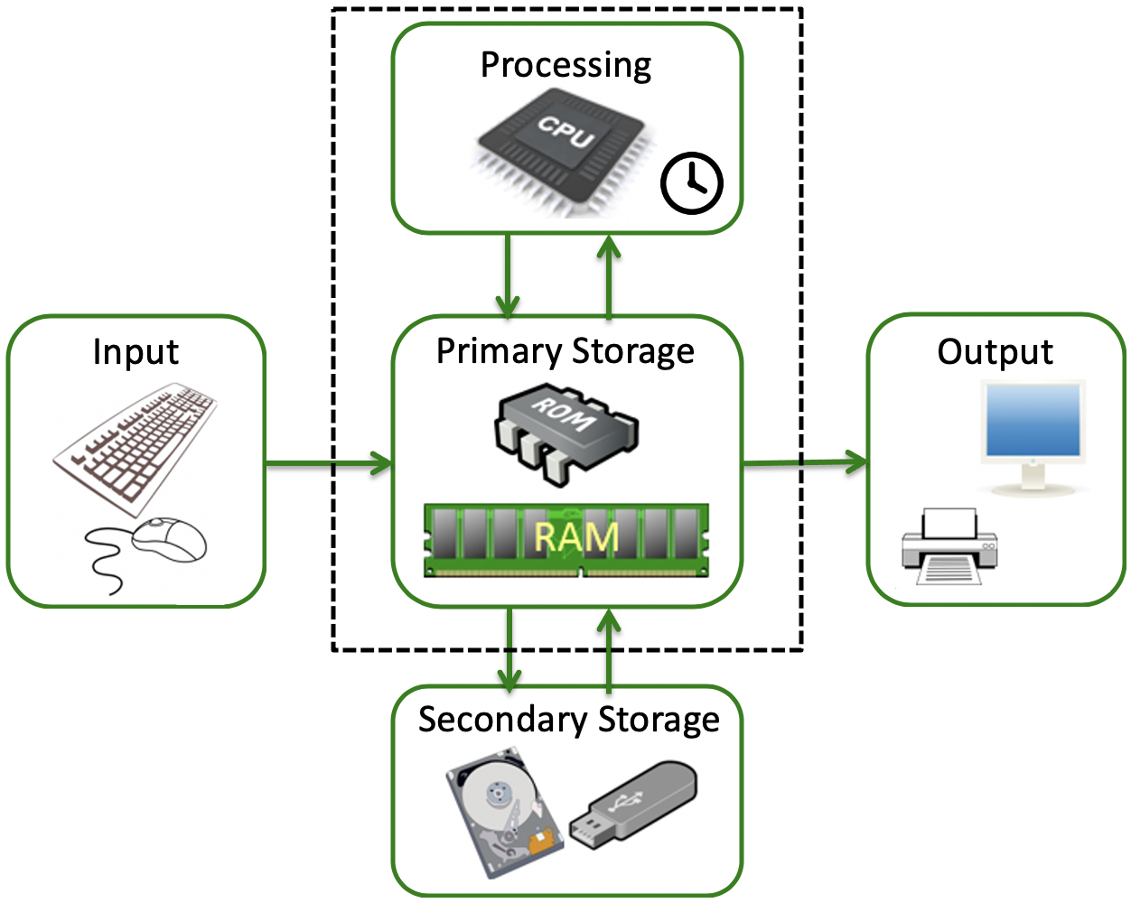
Hardware Components
Computer activity fundamentally consists of:

Slide 38
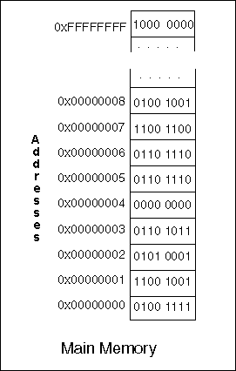
Computer Memory
Main Memory
An array of cells with each cell holding a single bit of information
Directly accessed by the processor
Stores instructions and data while a program is running
Comprised of ROM and RAM
RAM (Random Access Memory) is volatile read/write memory that is lost when power is turned off
ROM (Read Only Memory) is non-volatile read-only memory that retains stored data even if power is turned off
Address
Number that identifies a memory location

Slide 39
1.9 Why Whitespace Matters

Slide 40
Whitespace in Python
Whitespace is meaningful in Python, especially indentation and placement of newlines
Only the indentation level of your statements is significant (i.e. the whitespace at the very left of your statements). The whitespace needs to be consistent. So if you start using 4 spaces, you have to consistently use 4 spaces for the entire block. If you use a tab, you now have to use a tab.
Use a newline to end a line of code
Use \n when you must go to the next line prematurely
Instead of braces {} to mark blocks of code, use consistent indentation instead
First line with less indentation is outside of the block
First line with more indentation starts a nested block
Colons : start a new block in may constructs
E.g., function definitions, then clauses, etc.
In Java/C++, indenting is optional, but in Python, you must indent

